Slide 1

Market Basket Analysis
Market basket analysis is a data mining technique that helps you discover associations between products purchased together. By analyzing customer transaction data, you can gain valuable insights into buying patterns and customer behavior.
S. Kangana Sri
192210006

Slide 2
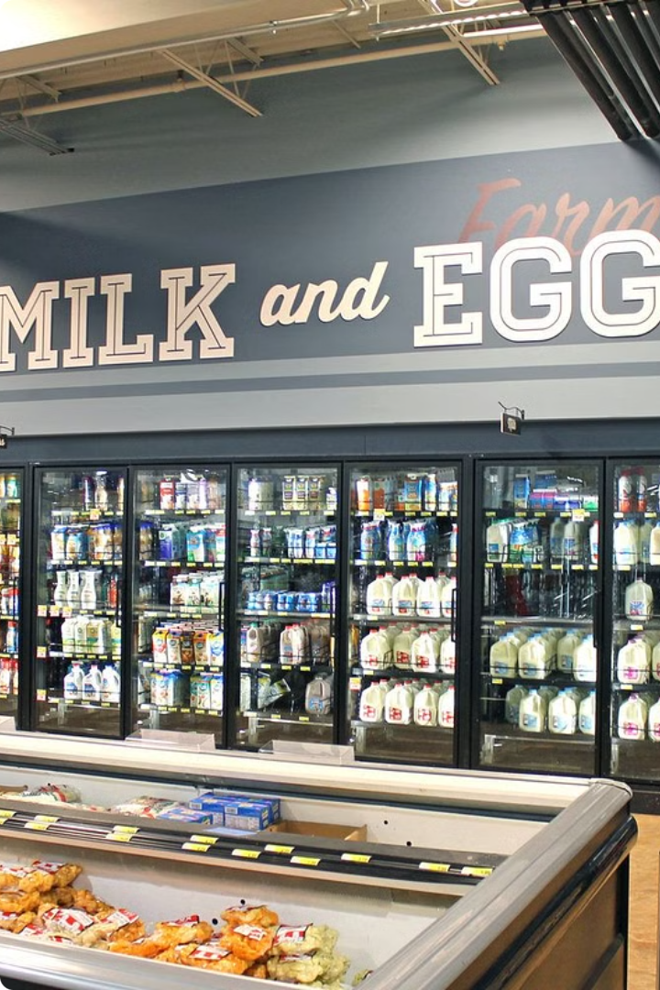
What is Market Basket Analysis?
Market basket analysis is a data mining technique used to identify relationships between items purchased together.
It helps businesses understand customer buying habits and predict future purchases.
For example, if customers often buy milk and bread together, a store might place these items near each other.

Slide 3

Importance of Market Basket Analysis
Market basket analysis helps businesses identify relationships between products purchased together.
The insights from this analysis can guide strategic decisions, boosting sales and profitability.
Businesses can use these insights to optimize product placements, create targeted promotions, and personalize customer experiences.
By understanding buying patterns, businesses can effectively respond to customer needs and preferences.

Slide 4

Techniques and Algorithms
Association Rule Mining: Discovering relationships between items in a dataset.
Apriori Algorithm: Efficiently identifies frequent itemsets and generates association rules.
FP-Growth Algorithm: A tree-based approach for efficient mining of frequent itemsets.
Lift, Support, and Confidence: Metrics to evaluate the strength and significance of associations.

Slide 5
Data Requirements
Market basket analysis requires transactional data, specifically customer purchase history. This data should include unique identifiers for each transaction and the items purchased within each transaction. To ensure accuracy, the data should be complete, consistent, and free of errors.
To effectively analyze associations and patterns, the data should be large enough to provide statistically significant results. The more data you have, the more accurate your insights will be.

Slide 6
Identifying Associations and Patterns
Market basket analysis algorithms use statistical techniques to identify strong associations between products or items purchased together.
Apriori algorithm is a popular technique used to generate frequent itemsets and association rules.
These patterns can be represented as association rules, which show the probability of buying one item given that another item has been purchased.
For example, a rule could be "If a customer buys diapers, they are likely to also buy baby wipes." This information can be used to inform marketing strategies and product placement.

Slide 7

Interpreting Results
The results of the market basket analysis provide valuable insights into customer purchasing behavior. These insights can be interpreted to understand the relationships between products and identify patterns.
For example, if a high percentage of customers who buy diapers also buy baby wipes, it indicates a strong association between these products. The analysis helps identify these associations, allowing businesses to understand which products are frequently bought together.

Slide 8
Applying Insights to Business Decisions
Market basket analysis uncovers hidden patterns in customer purchasing behavior. This can inform various business decisions, optimizing operations and driving growth.
Retailers can leverage these insights to optimize product placement, design targeted promotions, and personalize customer experiences. By understanding frequently co-purchased items, businesses can create compelling product bundles, enhance cross-selling strategies, and even predict future demand.

Slide 9
Applications
E-commerce: Recommend products based on past purchases.
Retail: Optimize store layouts and promotions.
Healthcare: Identify risk factors and predict patient outcomes.
Finance: Detect fraud and predict stock prices.
Marketing: Target customers with personalized offers.

Slide 10
Conclusion
Market basket analysis can provide valuable insights into customer behavior. By identifying associations between products, businesses can make informed decisions about pricing, product placement, and promotional strategies. This analysis can enhance customer experience and boost revenue.
From product recommendations to targeted marketing campaigns, the applications of market basket analysis are vast. By understanding and leveraging these insights, businesses can gain a competitive edge and optimize their operations.

